Slide 1
Chapter 9:
Criminal Court System

Slide 2
Criminal court structure
Provincial
Federal
Organizing, administering & maintaining criminal court system
Provincial Legislatures appoint judges to Provincial Courts
BC
  highest trial court: BC Supreme Court (trial & appeal)
  Highest court: BC Court of Appeal
Criminal Law & procedure
Create courts to administer justice
  Supreme Court of Canada
  Federal Court of Canada
  Tax Court of Canada
Federal Government appoints judges to superior courts & provincial Courts of Appeal

Slide 3
Provincial Court System
Preliminary Hearing:
Determine whether there is sufficient evidence to proceed
Screening process, avoids unnecessary trials
Appeal:
An application to a higher court to review the decision
Summary– single judge
Indictable– panel of 3-5
Notes:
Page 255
Superior courts have jurisdiction over criminal and civil
Different provinces have differently names courts: Court of Queens Bench (AB, SK, MB, NB) Superior Court of Quebec
Provincial Courts: summary convictions, if accused chooses provincial– by judge alone, tries provincial statutes, municipal bylaws

Slide 4
Notes:
Section 553 (theft, but not cattle, fraud, theft, money laundering, mischief, gambling)
Section 554– all others not covered
Section 469 offences (treason, alarming her Majesty, intimidating an MP, piracy & murder)– must be judge & jury unless agreed upon by defence and Attorney General

Slide 5
Federal Court System
Federal Court:
Jurisdiction over civil & criminal cases referred by federal boards, commissions, or tribunals, constitutional issues brought forward by Attorney General
Supreme Court of Canada:
Highest appeals court, deals with Constitutional questions as refereed by the federal government
Notes:
Supreme Court
A chief Justice & 8 Justices appointed by federal government (law: 3 must be Quebecois, tradition: 3 Ontario, 2 West, 1 Atlantic)
Panel of 5, 7 or 9– depending on issue
Grants “leave”-- permission to only cases with national significance approx. 8% of requests
Eg. 1996 Quebec Referendum & clarity of legality to secession (yes, but only after amendment negotiations)
Tax Court-- income taxes,
Nisga’a Nation– Nisga’a Court
Sentencing Circles– restorative justice: perpetrator, victim and families to heal community (less than 2 years)

Slide 6
Fundamental Principles
Innocent until proven guilty
Beyond a reasonable doubt: a standard of proof whereby a defendant’s guilt must be proven to the extent that a reasonable person would have no choice but to conclude that the defendant did indeed commit the offence
Implication for historical trial?

Slide 7
Participants
Judge: appointed, instructs jury or makes decisions on guilt/innocence and sentencing
Justice of the Peace: less authority than judge, but can issues warrants
Court Clerk: keeps records of exhibits, oaths
Court Reporter: records verbatim, transcript
Sheriff: court security, handles accused while in custody

Slide 8
Lawyers
Defence
Prosecution
Accused/ Defendant: person charged with committing offence
Duty Counsel: provides free legal advice when charged or interrogated, understand plea, bail
Defence Counsel: lawyer who represents interests of accused, introduce reasonable doubt, limit sentence
Crown Counsel/ Prosecutor: lawyer representing government’s interests, must prepare case, assemble evidence, review exhibits, interview witnesses
Role is NOT to obtain conviction, but to submit credible evidence of a crime

Slide 9
Citizens
Witnesses
Issues?
Give first hand evidence
May be called by prosecutor or defense
Must swear an oath to tell the truth
Weakness?
Potential Pitfalls?
Subpoena: court order requiring the witness to appear*
Perjury: making false statements*
Notes:
Failure to appear = contempt of court, fined and/or 90 days
Very serious crime, indictable, 14 years
Staged disruption
20min eye witness testimony https://www.ted.com/talks/scott_fraser_the_problem_with_eyewitness_testimony?language=en

Slide 10
Role of the Jury
Jury
Selection
Group of 12 citizens, chosen from a pool of ordinary citizens (voters lists)
Qualifications: Canadian, over 18, lived in province for over a year– people working in the legal industry generally exempt
Listen to arguments, examine evidence, follow judges instructions, come to a unanimous decision if the accused is guilty beyond a reasonable doubt
Jury Panel: large group of potential jurors, randomly selected
Arraignment: first stage of criminal case, plea is entered
Names from jury panel randomly selected
Selected names go to the front of the court and face the accused
Crown or defence can object to inclusion
Challenge for cause (bias/unable)
Peremptory Challenge (no reason)
Continues until 12 are seated, with some alternates
Notes:
Peremptory Challenge originally existed to balance the scales for defense with powerful Crown (serious case: both have 20, more than 5 years = 12, less than 5 = 4)
2min video https://thecanadianjurysystem.weebly.com/jury-selection-process.html
4mins indigenous issues: https://www.macleans.ca/uncategorized/the-problems-with-jury-selection-explained/
Reform: https://www.cbc.ca/radio/thesundayedition/the-sunday-edition-february-18-2018-1.4538717/how-to-reform-canada-s-jury-system-1.4538728

Slide 11
Juror’s Oath
I swear to well and truly try and true Deliverance make between our sovereign lady the Queen and the accused at the bar, whom I have in charge, and true verdict give, according to the evidence, so help me God.

Slide 12
The criminal trial process
Crown’s Opening Statements
  Crown has the burden of proof, so must outline and provide all evidence before the defense
  The opening is not to be considered evidence, but treated as a introduction or “thesis”
Examination of witnesses
  Direct examination: ask witnesses to relay their observations of the crime or their evidence
  Cross-examination: other side tests the accuracy and demonstrates flaws or inaccuracies
Defense Responds
  When Crown is done, Defense can bring a motion of dismissal if case doesn’t provide evidence beyond reasonable doubt (yes = directed verdict)
  Defense opens their case, calls witnesses
  Defendant may or may not testify s.11 of CoR&F
  REBUT: Crown can challenge/ contradict any new evidence bought forth by the defense
  SURREBUTTAL: Defence counters Crown’s rebuttal.
After the accused is arraigned (enters plea)
After the jury is selected
Judge asks the jury to select a foreperson (leader & speaker)

Slide 13
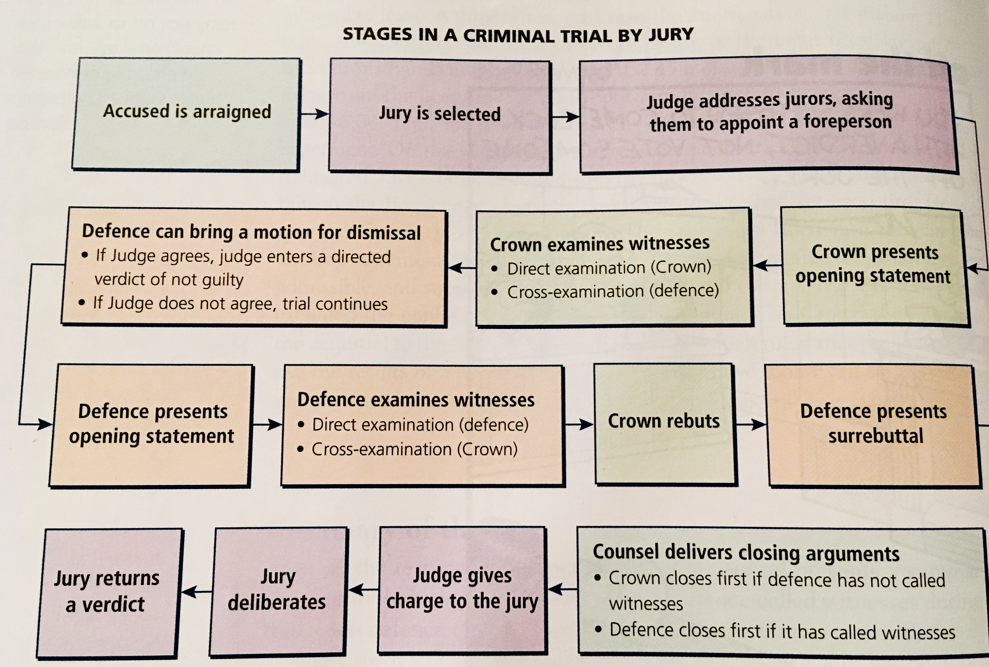
Notes:
https://www.youtube.com/watch?v=A1Sbj_rITyY

Slide 14
Rules of evidence
At any time, either counsel may object to questions asked, or answers provided by witnesses; most common:
Leading Questions
Hearsay Statements
Opinion statements
Immaterial or Irrelevant Questions
Non-responsive Answers
Notes:
Leading Questions: suggests an answer “you like taking law, don’t you?”, more acceptable during cross, on already established facts
Hearsay Statements: cannot testify to what was learned through a 3rd party “Jensen told me that you Beckett broke the lamp”
Opinion statements: can[‘t go beyond common knowledge if an expertise is required-– colour of car vs conditions of car’s brakes
Immaterial or Irrelevant Questions: no connection, inadmissible
Non-responsive Answers: reply that doesn’t answer the question, ask judge to direct witness to answer

Slide 15
Types of evidence
All evidence must be “material” = important and relevant
Direct: testimony given to prove an alleged fact
Circumstantial: indirect evidence that leads to reasonable inference
Character: likelihood defendant is the kind of person who would or wouldn’t commit a certain offence
Electronic Surveillance: use of electronic device to overhear, see and/or record conversations
  Wiretapping– intercepting of phones Bugging– hidden device, records & transmits
Polygraph tests: results inadmissible, but admissions are
Voir Dire: mini-trial, jury excused, determine admissibility of evidence without tainiting the jury
Notes:
Direct: witness testimony, can be challenged
Circumstantial: no direct witness, fingerprints on stolen purse (Judge decides if admissible)
Character: Crown not permitted to attack defendant’s character, defence can focus on good character (opens for rebut)
Electronic Surveillance: must be approved before hand by judge
Polygraph tests
Voir Dire

Slide 16
The Criminal Court System
Summary of the case
Charge to jury
Closing arguments (last chance) NOT considered evidence
If Defence has called witnesses, they go first
If Defence doesn’t call witnesses, Crown goes first
Defence goal to establish reasonable doubt
Crown goal to eastablish mens rea, actus reas
Judge’s explaintation to the juroros of how the law applies to the case before them
Advise how to consider evidence and return a verdict
Judge must be careful, ‘bad’ instructions can be grounds for an appeal (most common basis for successful appeal)
Judge decides matters of law (admissible), Jurors decide matters of fact (believable)

Slide 17
Result
Verdict
Appeals
Jurors weigh evidence, testimony and exhibits against reasonable doubt
Verdict must be unanimous, can ask jurors to be ‘polled’ and asked individually if they agree with verdict
Hung Jury: incapable of reaching consensus
Notice of appeal must be filed within 30 days– verdict or sentence
Possible outcomes: confirm, reverse, order new trial
Appellant: side filing appeal
Resondent: side responds to file
Completed by panel of 3-5 Judges, use transcript to review
Majority: explains decision in writing
Dissenting: can also publish why they disagreed with majority

