Slide 1
Chapter 8: Criminal Offenses

Slide 2
Review: Levels of offences
Hybrid
Indictable
Summary
Notes:
Examples:
Summary: public nudity, joyriding
Indictable: murder
Hybrid: assault

Slide 3
R v Trochym [2007] 1 S.C.R. 239
Charged with the murder of his girlfriend
Witness heard a man banging, didn’t see, but heard him admitted
Estimated time of death concluded that the person who entered the apartment was likely the murderer
Witness further testified they saw the boyfriend leave the apartment at 3pm Wednesday– contrary to the initial statement of Thursday
The witness clarified their story only after undergoing hypnosis
Why did the police want the witness to undergo hypnosis?
If hypnosis is not admissible in court, should it be used as an investigation tool?
Do you agree with the outcome?

Slide 4
Offences against the Person

Slide 5
Homicide
Section 222 (1) A person commits homicide when directly or indirectly, by any means, he causes the death of a human being
Culpable (murder, infanticide, manslaughter) vs
Non-culpable (unforeseeable accident, military orders, self-defense, capital punishment)
Notes:
Culpable: legally responsible (blamable)
Non-culpable: cannot be held legally responsible

Slide 9
Murder
Section 231
(1) Murder is first degree or second degree murder
(2) Murder is first degree when it is planned and deliberate
Contracted
Murder of a police officer
As a result of other crimes: hijacking, sexual assault, kidnapping, hostage taking
Terrorist activity
Criminal organization
(7) All murder that is not first degree murder is second degree
Minimum penalty for both: life imprisonment
Parole: 1st degree after 25 years, 2nd after 10-15

Slide 10
Historical tangent: faint hope clause
745.6 (1) Subject to subsections (2) to (2.6), a person may apply, in writing, to the appropriate Chief Justice in the province in which their conviction took place for a reduction in the number of years of imprisonment without eligibility for parole if the person
(a) has been convicted of murder or high treason;
(a.1) committed the murder or high treason before the day on which this paragraph comes into force;
(b) has been sentenced to imprisonment for life without eligibility for parole until more than fifteen years of their sentence has been served; and
(c) has served at least fifteen years of their sentence.
When Canada abolished death penalty (1976), sentences were converted to life in prison
Could apply after 15 years
Rationale gave hope, reducing risk to prison guards
Amended in 1997, 2011
Notes:
Used: 1508 eligible, 181 decisions, 146 eligible for early parole, 135 granted
1997 after Clifford Olson applied, it was amended to exclude multiple murders
2011: no longer available for offences committed after December 2, 2011

Slide 11
infanticide
233 A female person commits infanticide when by a wilful act or omission she causes the death of her newly-born child, if at the time of the act or omission she is not fully recovered from the effects of giving birth to the child and by reason thereof or of the effect of lactation consequent on the birth of the child her mind is then disturbed.
Conditions:
Natural mother,
victim is less than 12 months
must have been suffering from post-partem depression
Maximum penalty is 5 years imprisonment

Slide 12
Case Study: R v Leung
Do you think the punishment is fair?
Do you think the statue needs updating?
What other factors need to be considered?
Notes:
https://bc.ctvnews.ca/vancouver-woman-convicted-of-infanticide-gets-5-year-sentence-1.2043030 (video)
https://nationalpost.com/news/canada/canadas-infanticide-law-vague-outdated-and-rife-with-problems-alberta-government

Slide 13
Manslaughter
234 Culpable homicide that is not murder or infanticide is manslaughter.
Actus Reus: killing someone through an unlawful act, even if unintentional
Mens Rea: any reasonable person could forsee that the wrongful act would pose a risk of bodily harm
Can be used in cases of criminal negligence
Murder can be reduced if able to prove provocation (lose self-control) key: no cooling-off

Slide 14
Assault
Most common violent crime (82% of all reported)
Intentionally applying force, attempting or threatening, accosting, impeding, begging while carrying a weapon
Level 1:
Hybrid: max 5 years
Level 2: with a weapon or causing bodily harm
Hybrid: max 10 years
Level 3: aggravated assault
Wounding, maiming, disfiguring, or endangering life
Indictable: max 14 years

Slide 15
Sexual Assault
Originally, rape or indecent assault– change to recognize bodily harm, spouses can be charged, and victims can be any gender
Touching of a sexual nature that is not invited or consensual
Level 1: violates victims sexual integrity (97%)
Hybrid: max 10 years
Level 2: with a weapon, threats to 3rd party, or causing bodily harm
Hybrid: max 14 years
Level 3: aggravated sexual assault
Wounding, maiming, disfiguring, or endangering life of a victim
Indictable: max life imprisonment

Slide 16
Consent as a valid defence?
It is permissible if the accused had an honest and reasonable misunderstanding, even if mistaken, except:
When a victim says no by words or conduct
When the accused is intoxicated
When the accused was reckless or deliberately blind to the victim’s responses, or failed to take reasonable steps to confim consent
More details: Case study page 233

Slide 18
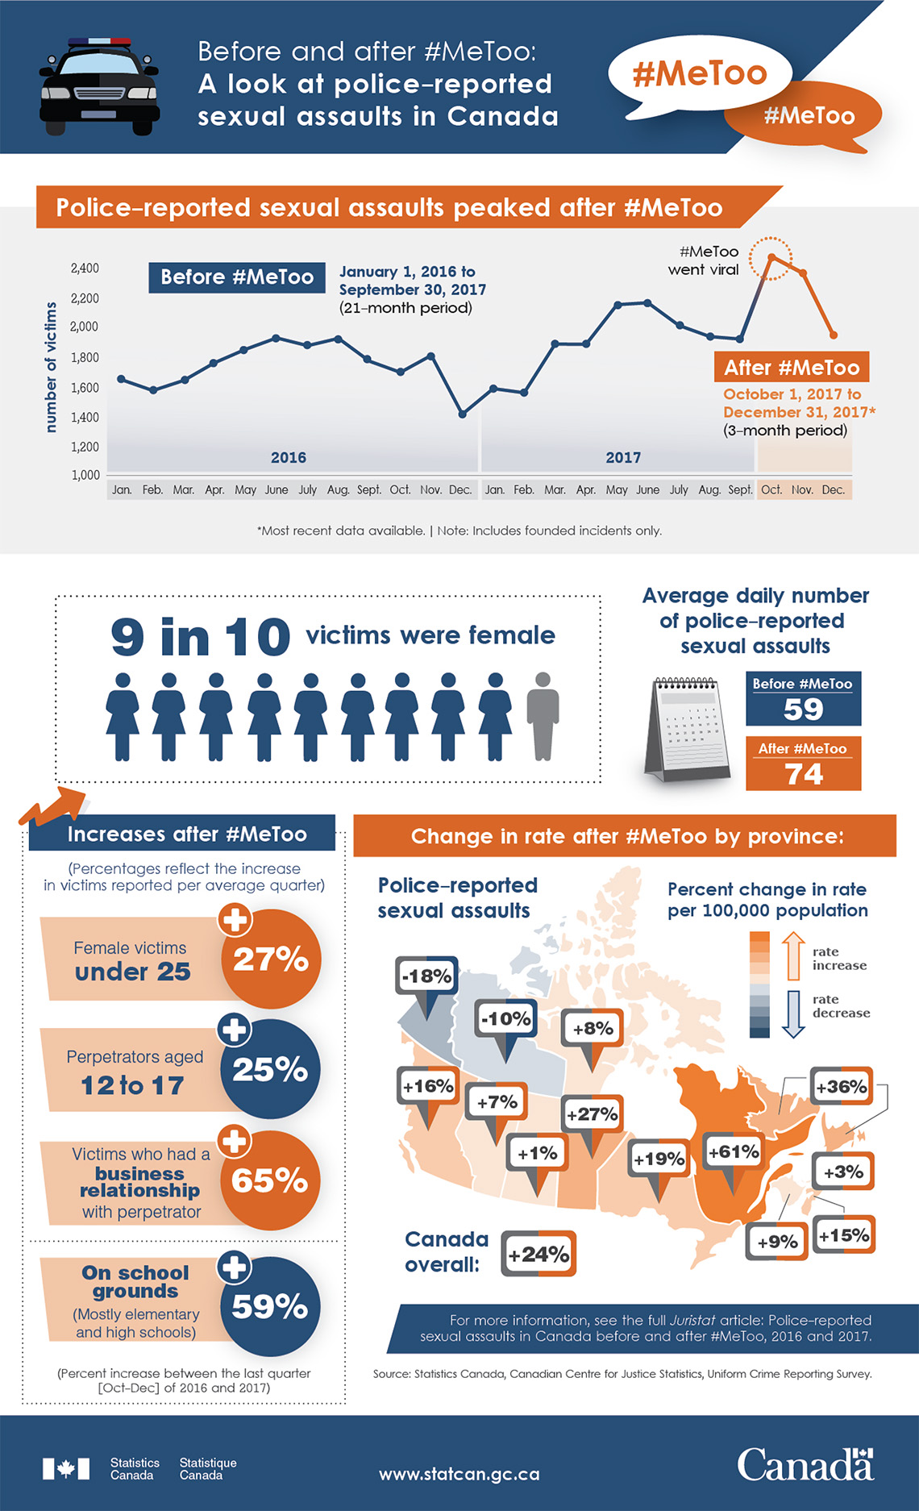

Slide 19
Motor vehicle offences
Dangerous Operation of a Motor Vehicle
320.13 (1) Everyone commits an offence who operates a conveyance in a manner that, having regard to all of the circumstances, is dangerous to the public.
Failure to stop at the scene of a crime (Sec 252(2))
Impaired Driving (Sec 253-5)
Repealed Bill C-46, June 2018
Updated definitions, testing, punishments
Case study: R v. Nightingale, 2007 Alta. P.C. 210 (page 235)
Discussion: Investigating Impaired Driving (page 236)

Slide 20
Offences against property
Protection of private property demonstrates the value
Part IX of the Criminal Code
Most common: theft, robbery & breaking & entering
Describe the difference between theft, robbery & break and enter.

Slide 22
theft
322 (1) Every one commits theft who fraudulently and without colour of right takes, or fraudulently and without colour of right converts to his use or to the use of another person, anything, whether animate or inanimate, with intent
(a) to deprive, temporarily or absolutely, the owner of it, or a person who has a special property or interest in it, of the thing or of his property or interest in it;
(b) to pledge it or deposit it as security;
(c) to part with it under a condition with respect to its return that the person who parts with it may be unable to perform; or
(d) to deal with it in such a manner that it cannot be restored in the condition in which it was at the time it was taken or converted.
“Colour of right”: honest belief that a person owns or has permission to use the article
Theft under $5000
Hybrid: max 2 years
Theft over $5000
Indictable: max 10 years
Case study page 238.
Notes:
Permission to borrow a car– states for three hours, takes a road trip, gone for three days
Pulled over & charged with theft… “keep the car as long as you want” example of colour of right
Charge?

Slide 23
Theft vs robbery
Theft: taking property permanently or temporarily without owners permission
Max: 10 years
Examples?
Robbery: theft with a weapon or threat of violence (sec 343)
1st time, 5 years
2nd time, 7 years
With a gun, Max: life imprisonment

Slide 24
Breaking & entering
Breaking and entering with intent, committing offence or breaking out
348 (1) Every one who
(a) breaks and enters a place with intent to commit an indictable offence therein,
(b) breaks and enters a place and commits an indictable offence therein, or
(c) breaks out of a place after
(i) committing an indictable offence therein, or
(ii) entering the place with intent to commit an indictable offence therein,
is guilty
(d) if the offence is committed in relation to a dwelling-house, of an indictable offence and liable to imprisonment for life, and
(e) if the offence is committed in relation to a place other than a dwelling-house, of an indictable offence and liable to imprisonment for a term not exceeding ten years or of an offence punishable on summary conviction.
Paul’s girlfriend, Mary, broke up with him, saying she just couldn’t deal with his temper anymore. One day, Paul sees Mary talking to another guy, and becomes angry. A couple of hours later, Paul goes looking for Mary at her parents’ home, and discovers that the “new guy” is there with Mary.
Enraged, Paul barges into the home – through the unlocked front door – and begins threatening the new guy. Paul begins throwing things, pulling pictures and decorations off the walls and tables, to hurl at the new guy, and through a window. When Paul realizes Mary has picked up the phone and is calling 9-1-1, he gets back in his car and drives away.

Slide 25
Other criminal code offences
Mischief vs Public Mischief
When is it more than vandalism?
Part XI: Wilful and Forbidden Acts
Willfully destroying, rendering useless, interfering with use of property or data
Eg. Vandalism
Hybrid: max life imprisonment
Part IV: Offences against the administration of law
Provides false information, misleads police investigation
Eg. Falsely reporting a stolen car
Hybrid: max 5 years
Notes:
Page 240 Acts of vandalism-- escalate?
Make Salmon Arm Straight Again

Slide 26
Notes:
Still rakes in approx. $700,000 annually
https://www.cnbc.com/2019/04/18/nigerian-prince-scams-still-rake-in-over-700000-dollars-a-year.html

Slide 27
Other criminal code offences
fraud
More information, sources
Part X: Fraudulent Transactions
Intentionally deceiving someone to cause a loss of property, money or service
Falsifying employment records
Failing to collect fares
Manipulating the stock market
Forging trademarks
Fraud under $5000: hybrid: max 2 years
Fraud over $5000: indictable: max 10
Podcasts:
Show:
The Perfect Scam
Episodes:
Planet Money Ep #680 “Anatomy of a Scam”
Notes:
https://www.npr.org/sections/money/2018/10/03/654124255/episode-680-anatomy-of-a-scam

Slide 28
Other criminal code offences
Prostitution & Soliciting
Stopping or impeding traffic
213 (1) Everyone is guilty of an offence punishable on summary conviction who, in a public place or in any place open to public view, for the purpose of offering, providing or obtaining sexual services for consideration,
(a) stops or attempts to stop any motor vehicle; or
(b) impedes the free flow of pedestrian or vehicular traffic or ingress to or egress from premises adjacent to that place.
(c) [Repealed, 2014, c. 25, s. 15]
Communicating to provide sexual services for consideration
(1.1) Everyone is guilty of an offence punishable on summary conviction who communicates with any person — for the purpose of offering or providing sexual services for consideration — in a public place, or in any place open to public view, that is or is next to a school ground, playground or daycare centre.
Notes:
Prostitution is not a criminal offence, but the act of solicitation
Summary Offence
Keeping a common bawdy house (s 210)
Living off the avails of prostitution (pimp) indictable, 10 years, 14 if prostitute is under 18
Case page 243

Slide 29
Other criminal code offences
gambling
Things to consider
Common Bawdy House
Place kept, occupied, used for the purposes of prostitution or indecent acts
Common Betting House
Place where people bet among themselves, but owner/house keeps portion
Common Gaming House
Place kept for gain or profit where people play games (eg. poker), owner keeps portion
Keeping a ‘disorderly house’ is an indictable offence, max 2 years.
Should the Government benefit from racetrack/ casino betting even though it is illegal for an individual to benefit?
Should gambling be legal?
Parq Vancouver pays $200,000/year to offset negative impacts of casino
Notes:
BC
Fee imposed on persons betting at racecourses
16 (1) There must be levied and collected in the manner provided in this section, from every person who bets in British Columbia on a race held in British Columbia or elsewhere under the system known as the pari mutuel, a fee to be paid to the government equal to
(a)2.5% of the amount of money deposited by that person with the operator at the time of making a bet other than in a triactor pool, and
(b)4.5% of the amount of money deposited by that person with the operator at the time of making a bet in a triactor pool.

Slide 30
Drug offences
Controlled Drug and Substance Act (1997) replaced Narcotic Control Act and parts of the Food & Drug Act
“Controlled substance” defined by list set out in schedule I-VI

Slide 31
possession
Definitions
Penalties
State of having knowledge of and control over illicit drugs
Conditions:
Person in possession must know what the item is, and some control over it
Person found in possession, even if they gave the item to someone else
Doesn’t have possession, but awareness and consents to its possession by someone else
Schedule 1
Indictable: 7 years
Summary: 1st $1000 and/or 6 months
2nd: $2000 and/or 1 year
Schedule II
Indictable: 5 years - a day
Summary: as above
Schedule III
Indictable: 3 years
Summary: as above
Schedule IV & V
Not offence
Notes:
Planted– unaware– no crime
Planter– crime (point 2)
Two friends… Express consent “yes!” implied consent no “no!”
Page 245
I opium & derivatives
II cannabid & derivatives
III amphetamines
VI barbiturates
V phenykpropanolamines

Slide 32
Trafficking, and Possession for purpose of trafficking
Definitions
Penalties
Sell, give, administer, transport, send, deliver, or distribute controlled substances, sell authorization, or offer services of the above.
Conditions:
Intention can be proven if the amount exceeds personal use
Presence of other tools: scales, bags, lists of names, or a large amount of cash
Prove intent to make an offer, not intent to carry out
Schedule 1& II
Indictable: life imprisonment
Schedule III
Indictable: 10 years
Summary: 18 months
Schedule IV
Indictable: 3 years
Summary: 1 year

Slide 33
Money laundering
Definitions
462.31 (1) Every one commits an offence who uses, transfers the possession of, sends or delivers to any person or place, transports, transmits, alters, disposes of or otherwise deals with, in any manner and by any means, any property or any proceeds of any property with intent to conceal or convert that property or those proceeds, knowing or believing that, or being reckless as to whether, all or a part of that property or of those proceeds was obtained or derived directly or indirectly as a result of
(a) the commission in Canada of a designated offence; or
(b) an act or omission anywhere that, if it had occurred in Canada, would have constituted a designated offence.
Transferring cash or other property to conceal its illegal origin
Conditions:
Actus Reus: wide range of activities; use, transfer, possession, sending, delivering, transporting, transmitting, altering, disposing, dealing with proceeds
Mens rea: intention to conceal, knowledge of criminal origins
“Subject matter of the offence” participating in a conspiracy or attempt, counsel, accessory after
Notes:
https://www.youtube.com/watch?v=KXTaksJxO90 (Ozarks- some nudity)
Indictable: 10 years
Summary: $2000 and/or 6 months
** police allowed to seize anything they believe, on reasonable grounds, obtained with money or illegal origin

Slide 34
Practice debates
Choose one issues, and find a partner
As a team, review the provided articles and identify facts vs opinions
Build a pro/con T chart about your issue
Create counter arguments for each argument
When you are done, you will be asked to defend one of the sides
Finally, write your own conclusion and submit tomorrow
Gun Control
Long gun registry requirements are intrusive, discriminatory, and unconstitutional.
Supervised Injection Sites
Safe injection sites like Insite make for healthy, happy communities.
Notes:
SD35 databases

